Slide 1
World Diabetes Day – Screening Data Analysis
Ahmedabad Medical Association

Slide 2
Summary of Screening Data
• Total Patients Screened: 2221
• High Blood Sugar: 644 (29.0%)
• High Blood Pressure: 772 (34.8%)
Note: This is interim data from the first session and a few centres. Final consolidated data from all 103 centres will be released after verification.

Slide 3
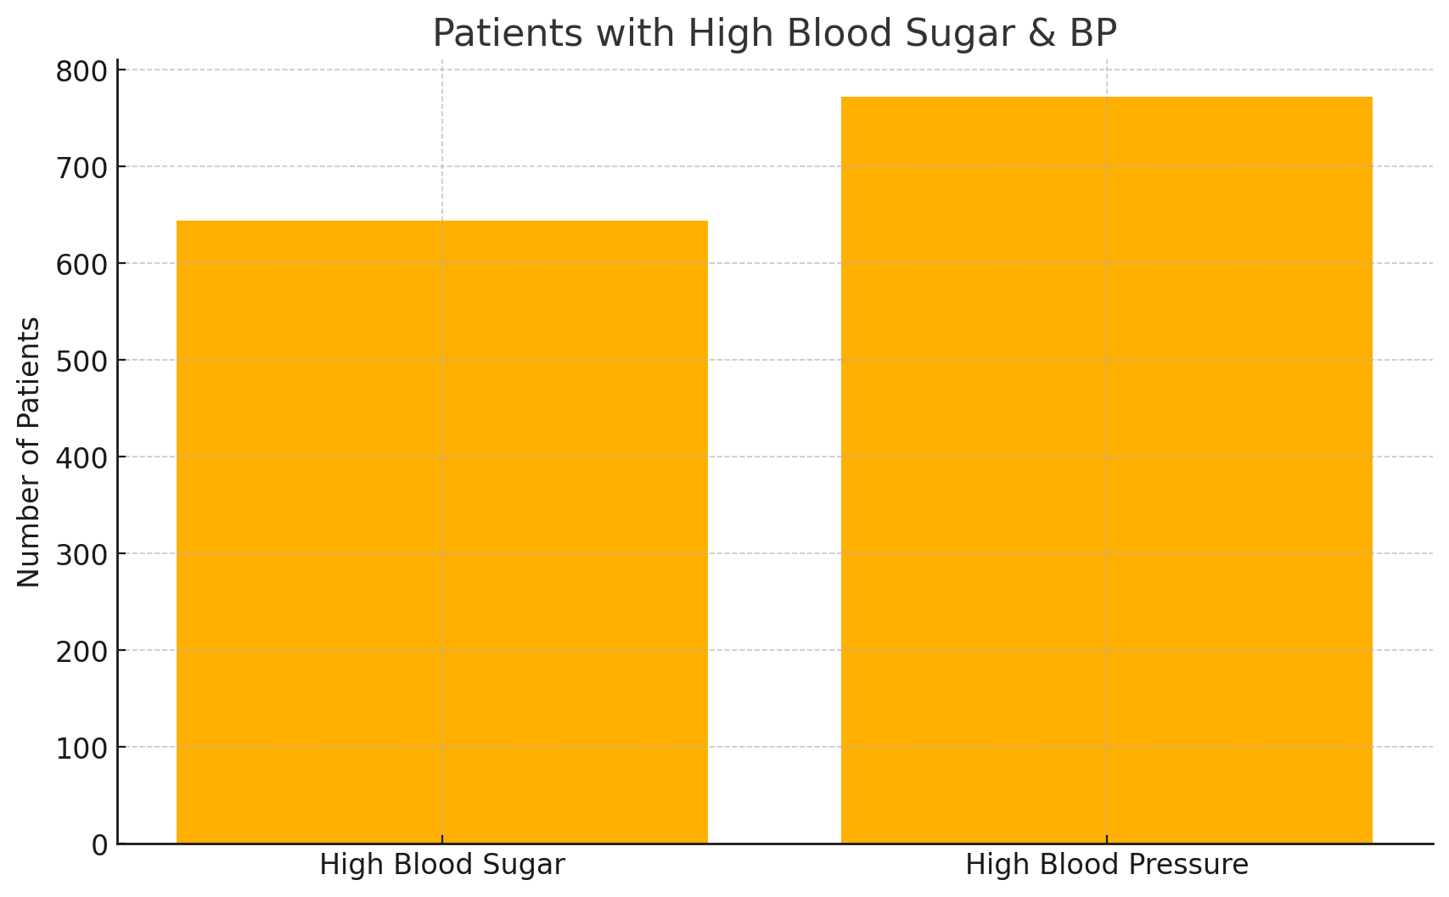
Graphical Analysis
Note: Preliminary data from limited centres. Final figures pending.

